Slide 1
SWACHHTA ABHIYAN (2018-19) SWACHH BHARAT

Slide 2
Presented By – ECOLOGY CLUB
CITY VOCATIONAL PUBLIC SCHOOL
250 , Circular Road , MEERUT CANTT

Slide 3
Directed By – Honourable Principal Sir
Mr. PREM MEHTA

Slide 4
Produced By – Coordinator
Mr. ASHOK LOHANI

Slide 5
Staff Member – 1. P.G.T BIOLOGY
Ms. SHWETA SHARMA
2. T.G.T SCIENCE
Ms. SHWETA SHARMA
3. P.G.T CHEMISTRY
Ms. KAVITA MALHOTRA

Slide 6
Honourable Guest – Mr. PRAHBAT ROY
Capt. C.S. YADAV

Slide 7
Speech Given By Students - AKANSHA VERMA XII A
SAGAR MALIK IX A

Slide 8
ACKNOWLEDGMENT
The entire family Of ECOLOGY CLUB Of CITY VOCATIONAL PUBLIC SCHOOL , would like to thank CHAWANI PARISHAD , MEERUT CANTT for giving us such a wonderful job of SWACHH BHARAT ABHIYAN and to be a part of SWACHH BHARAT MISSION (2018-19) .
Submitted To ; Submitted By :
CHAWANI PARISHAD ECOLOGY CLUB
MEERUT CANTT CITY VOCATIONAL
PUBLIC SCHOOL

Slide 9
CONTENT
Speech By Mr. Ashok Lohani to make the students aware regarding “SWACHHTA MOHUA APP – 2018” .
Seminar conducted on 5 Nov. 2018 .
Speech given by Students and Teacher .
Wall painting on 22 Nov. 2018 .
A skit of SWACHH SARVEKSHAN ABHIYAN – 2018 .
VERMICOMPOSTING in City Vocational Public School .

Slide 10
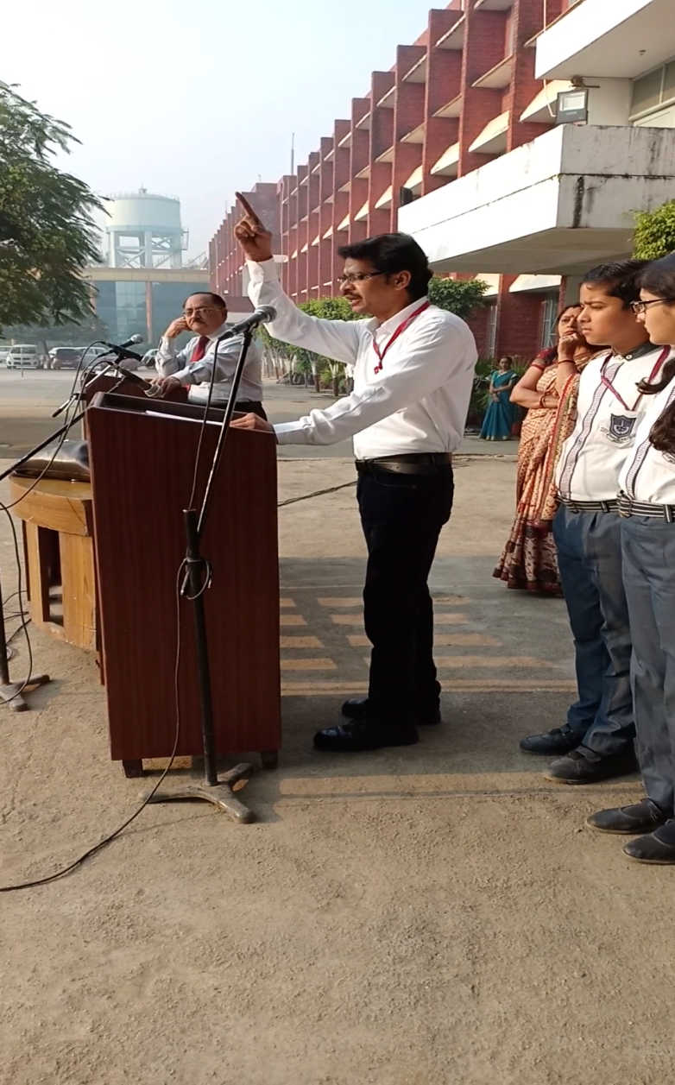


SPEECH BY Mr. ASHOK LOHANI On “SWACHHTA MOUHA APP-2018”

Slide 11
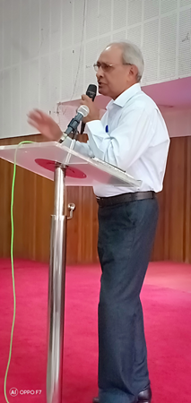
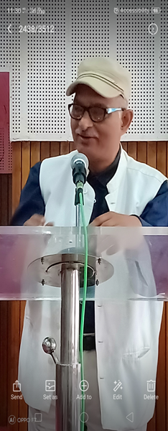
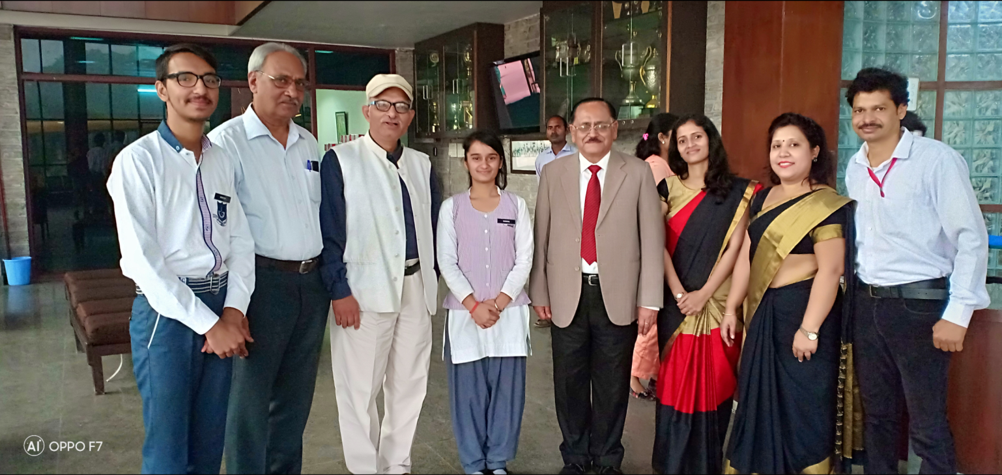
SEMINAR CONDUCTED ON 5 Nov 2018

Slide 12
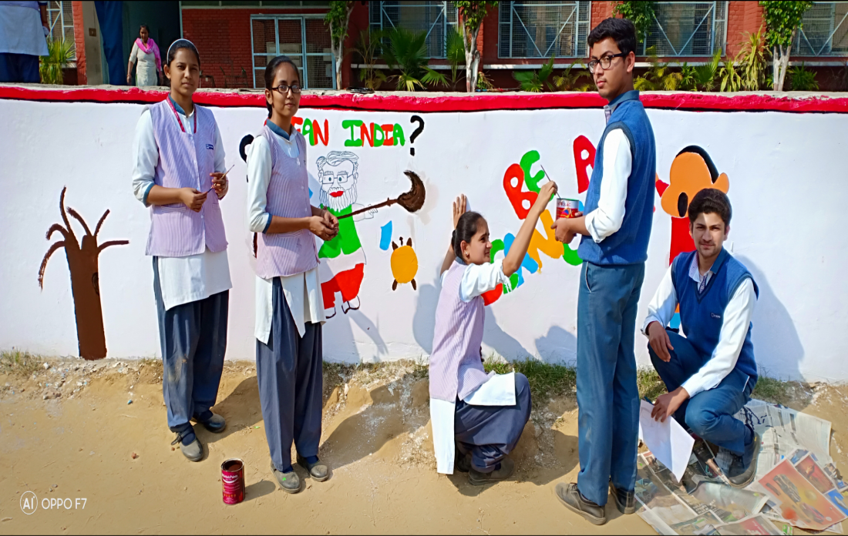
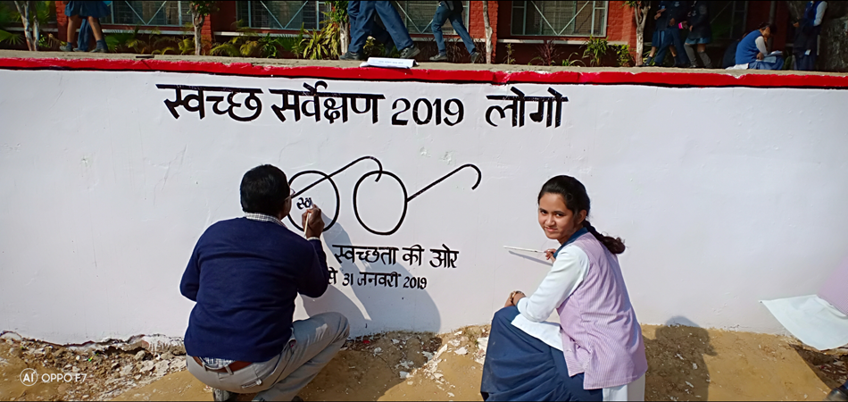

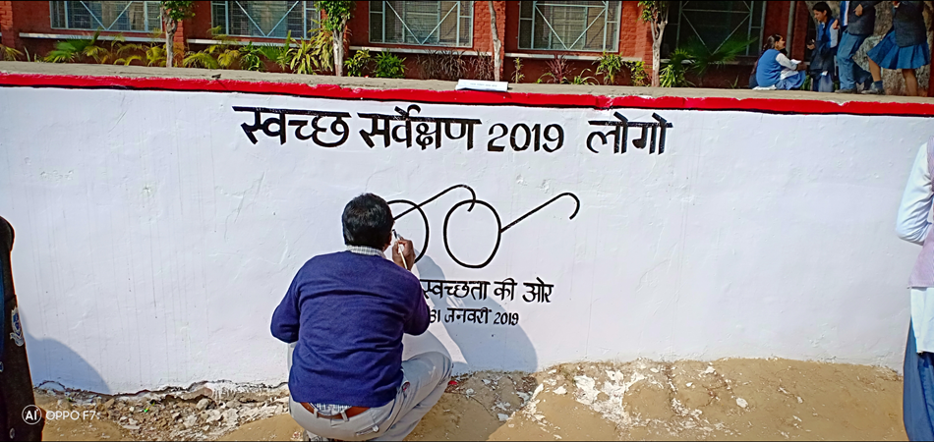
WALL PAINTING

Slide 13
`
In the end we ECOLOGY CLUB OF CITY VOCATIONAL PUBLIC SCHHOL wants to thanks with all our love to CHAWANI PARISHAD MEERUT CANTT for giving us this wonderful information on “SWACHHTA MUHA APP” and making us aware to work more in makinng our INDIA clean .
THANK YOU .
PPT created by
Abhay Gupta
XA

